Slide 1
CO – CREATION AND PRODUCT DESIGN CO – CREATION AND PRODUCT DESIGN CCO – CREATION AND PRODUCT DESIGN
Unit – II: IDEATION PROCESS
Contents:
Articulation of Problem Statement,
Visualizing Ideas,
Communicating ideas and compelling story telling,
Brainstorming,
Divergent thinking in exploring solutions,
3- Box Thinking,
3- Box Framework and
Box-3 Ideation.

Slide 2
Articulation of Problem Statement
Point of view, or POV, in design thinking is a written, actionable statement that expresses the problem that the design team is trying to address. This is also often called a problem statement.
That is, an expression of the problem (or problems that customers identified the Empathize stage, In fact, crafting a POV statement is the central purpose of the Define stage of design thinking. It provides a framework for designers to use in later brainstorming sessions.
“If I had an hour to solve a problem, I’d spend 55 minutes thinking about the problem and five minutes thinking about solutions.” – Albert Einstein

Slide 3

Articulation of Problem Statement
User need statements, also often called problem statements or point-of-view statements, are the primary tool in the second stage of design thinking — the define stage.
It defines what you want to solve before you move on to generating potential solutions, in order to
1) Condense your perspective on
2) Provide a metric for success to be used throughout the design thinking process.

Slide 4
Steps for creating POV:
Step 1: Identify Users, Needs & Insights : There are three key components that make up the POV statement:
User: Defines the type of specific user whom writing POV about.
Need: Identifies the users’ essential needs/goals.
Surprising Insight: Synthesizes the gathered information into a key takeaway. This statement can be used to design a solution.
Step 2: Create Your Chart: Place your scenario into a template like the example below. This creates a guide for structuring your POV statement.

Slide 5
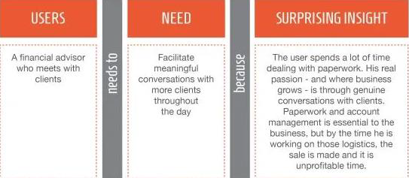

Step 3: Form Your POV Statement : This is the fun part where you combine your user, needs and insight into a concise POV statement. If necessary, condense your statements to create a good story.

Slide 6
A good problem statement should thus have the following traits. It should be:
Human - Centered. This requires you to frame your problem statement according to specific users, their needs and the insights that your team has gained in the Empathize phase.
Broad enough for creative freedom. This means that the problem statement should not focus too narrowly on a specific method regarding the implementation of the solution.
Narrow enough to make it manageable. On the other hand, a problem statement such as, “Improve the human condition,” is too broad and will likely cause team members to easily feel daunted.

Slide 7
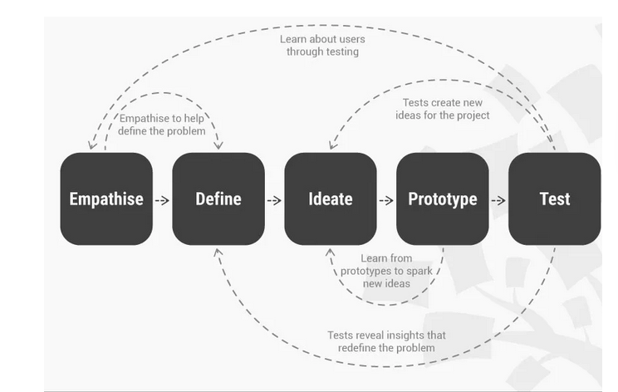
Visualizing Ideas

Slide 8
Ideation Will Help You:
Ask the right questions and innovate.
Step beyond the obvious solutions and therefore increase the innovation potential of your solution.
Bring together perspectives and strengths of team members.
Uncover unexpected areas of innovation.
Create volume and variety in your innovation options.
Get obvious solutions out of your heads, and drive your team beyond them.

Slide 9
Communicating Ideas and Compelling Story Telling
Storytelling is the art of using language, and storytelling as a communication tool is the means to achieve certain communication goals.
In a business context, storytelling has many uses and a multitude of Benefits:
Stories—about products, customers, employees—make brands relatable to stakeholders. “That girl in the commercial is frustrated with her car insurance, just like me!”
Stories—about business approaches, attitudes and promises—build brand loyalty. “That guy in the testimonial was so happy about his purchase; I’ve got to check that company out.”
Stories—about recent events and announcements—create awareness. “I just read on their blog that they have a new program and it sounds like it could be fun. We should try it out!

Slide 10
Communicating Ideas and Compelling Story Telling
“The Story Factor” author Annette Simmons suggests that there are Six Kinds Of Stories that all business leaders and communicators should be able to tell well.
Who I Am – Stories of self revelation, like how a business came to be.
Why I am Here – Stories of motivation, like why a customer decided to buy.
The Vision – Tales of where we are going, like the announcement of a new product.
Teaching Stories – Tales of why and how, like tutorials on how best to use a brand’s service.
Values in Action – Stories of how values intersect the real world, like how a nonprofit helps its community through its programs.
I Know What You are Thinking – Tales to overcome objections, like a political ad addressing an opponent.

Slide 11
Communicating Ideas and Compelling Story Telling
Characteristics Of A Great Story
Seth Godin - A story worth telling is worth telling well
A great story is true. Not necessarily because it’s factual, but because it’s consistent and authentic.
Great stories are trusted. no marketer succeeds in telling a story unless he has earned the credibility to tell that story.
Great stories happen fast. First impressions are far more powerful than we give them credit for.
Great stories don’t appeal to logic, but they often appeal to our senses.
Great stories are rarely aimed at everyone.
Great stories agree with our world view. The best stories don’t teach people anything new. Instead, the best stories agree with what the audience already believes.

Slide 12


Communicating Ideas and Compelling Story Telling
For example, consider these topics that double as storytelling strategies:
Breaking News
Educational
Thought Leadership
Product Launch
Brand Awareness
Crisis Management
Persistent Presence
Community Relations
Corporate Social Responsibility

Slide 13
Communicating Ideas and Compelling Story Telling
Measuring the effectiveness of your stories is simple—benchmark them with goals and consider the stories your brand has created in comparison to those who have elected to tell your stories for you.
Website traffic, social media conversations, email conversions, sales figures—these are all great indicators for doing so.
Telling a story also requires that you involve your listener by building the story around them, talking of a situation they are most likely to be in.
Depending on the medium, you can even get them to participate in the storytelling process—social media platforms, comment enabling on product sites and blogs, customer satisfaction surveys.

Slide 14
Brainstorming
Brainstorming gives permission to think expansively and without any organizational, operational, or technological constraints.
Brainstorms require generating 100 ideas (many of which are silly or impossible) in order to come up with those three truly inspirational solutions.
“7” Brainstorming Rules
Defer judgment There are no bad ideas at this point. There will be plenty of time to judge ideas later.
Encourage wild ideas It’s the wild ideas that often create real innovation. It is always easy to bring ideas down to earth later!
Build on the ideas of others Think in terms of ‘and’ instead of ‘but.’ If you dislike someone’s idea, challenge yourself to build on it and make it better.

Slide 15
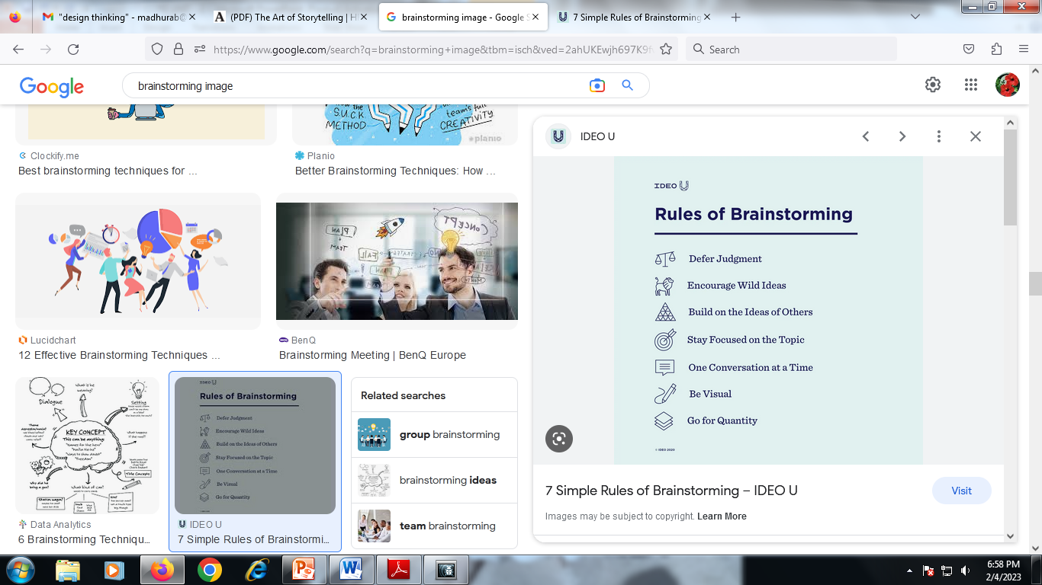
Brainstorming
Stay focused on topic You will get better output if everyone is disciplined.
Be visual Try to engage the logical and the creative sides
of the brain.
One conversation at a time Allow ideas to be heard and built upon.
Go for quantity Set a big goal for number of ideas and surpass it! Remember there is no need to make a lengthy case for your idea since no one is judging. Ideas should flow quickly.

Slide 16
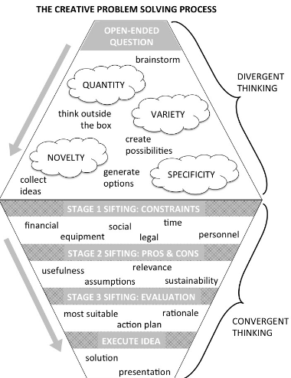
Divergent Thinking In Exploring Solutions
Divergent thinking is the process of generating multiple ideas to maximize the range of possible solutions, applications, examples, etc.
It is the initial stage of creative problem solving where learners have the space and freedom to explore out-of-the-box ideas, take risks, push beyond obvious answers, probe deeper, and defy some of the conventional boundaries and constraints of a particular discipline.
Typically, divergent thinking involves brainstorming, collecting spontaneous and random associations with a given topic, and increasingly expansive ideation

Slide 17
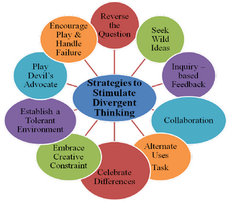
Divergent Thinking In Exploring Solutions
DIVERGENT THINKING - IMPORTANT
Opens possibilities of innovative ways to solve more complex problems, overcoming the tendency of many learners to only work within the confines of first impressions or latent assumptions.
Fosters empathic understanding of difference and appreciation of varying perspectives.
Builds on learners’ curiosity, encouraging experimentation, risk taking, perseverance through failure, and self-expression.
Develops creativity, which is often cited as one of the most in-demand skills by employers.
Apple, Netflix, Amazon, Tencent, Unity, SpaceX, Unreal

Slide 18
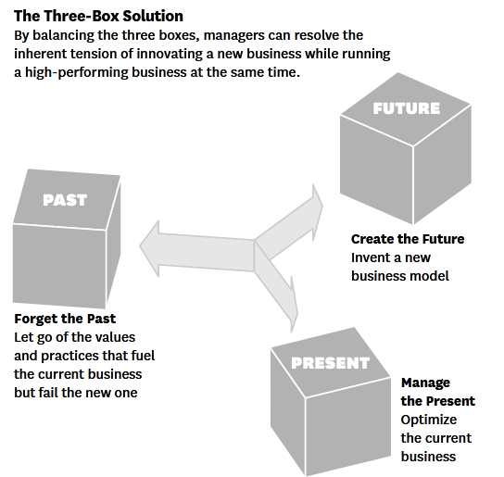
3- Box Thinking

Slide 19
3- Box Framework
Vijay Govindarajan - The Three-Box Solution: A Strategy for Leading Innovation.
Manage the present, box one; selectively abandon the past, box two; and create the future, box three. Box one is competition for the present, that's all about efficiency . Box two, box three is competition for the future, that's all about innovation.
Amazon is a great example of box 3 balance, because they have expanded their product and services offerings (competing with Walmart in retailing, competing with IBM for data storage, and competing with Apple as a device maker). Companies have to constantly maintain the three box balance in the tech industry

Slide 20
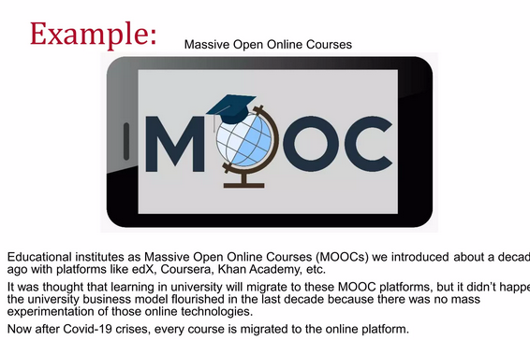
3- Box Framework

Slide 21
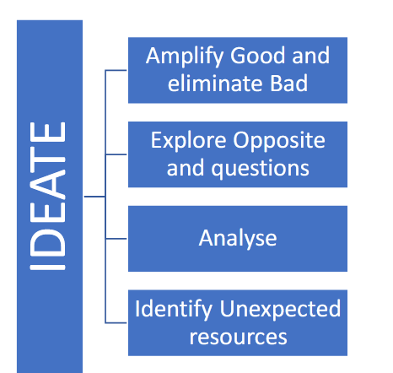
Box-3 Ideation
The Idea Box is a matrix tool in which you insert all of the different parameters of a design so that you can see them clearly. An Idea Box is a little box filled with wood coins that hold activities, ideas, chores, story starters and more

Slide 22
To be a good idea, it needs to be focused on the people, are how the idea fits the needs, problems, and their goals.
That is why it is important to understand how the ideas gives values and the usefulness to the beautiful or feasible solution.
This ideate phase of the design thinking processes is the most interesting and perhaps, the most rigorous as well.
In this phase designer or designers supposed to bring to the table as many ideas as possible.
The ideate stage is important because it is when a design team moves from understanding and defining consumer/user/client/customer problems to coming up with solutions for those needs.
Without the ideate stage the problem remains just the problem.
Design team consider creative ways to address the needs of the user in the empathize stage and outlines in the Define stage

